Slide 1
Triplet Loss for Knowledge Distillation
Team No 7:
Sashank S (2021701038)

Slide 2
01.
Introduction & Proposal
04.
Results
02.
Project Expectations
05.
Future Works
03.
Implementation Details
06.
References

Slide 3
01
Introduction &
Proposal

Slide 4
Problem
Statement
Knowledge distillation - technique for transferring knowledge of deep ensemble models with many parameters (teacher model) to smaller shallow models (student model)
Purpose of knowledge distillation is to increase the similarity between the
teacher model and the student model
The Task : Make the
student model closer to the teacher model using pairs or triplets of the training samples.

Slide 5
Goals
Goal 1
Goal 2
Goal 3
Build a model that can increase the similarity of outputs for similar samples.
Metric learning aims at reducing the distance between similar and increasing the distance between dissimilar.
The functionality of the metric
learning to reduce the differences between similar outputs can be used for the knowledge distillation to reduce the differences between the outputs of the teacher model and the student model.
Use metric learning to clarify the difference between
the different outputs, and improve the performance of the student model.

Slide 6
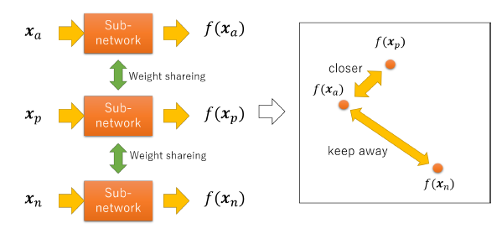
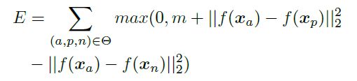
Triplet Network
Triplet Network is designed to learn embedding from a triplet of samples called ”anchor”, ”positive” and ”negative”.
The triplet network learns embedding such that the distance between ”anchor” and ”positive” is smaller than the distance between ”anchor” and ”negative”.

Slide 7
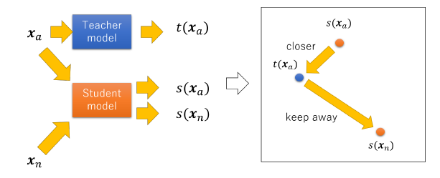
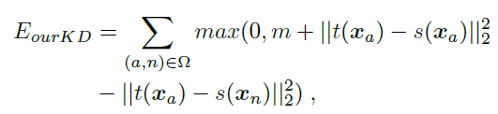

Architecture

Slide 8
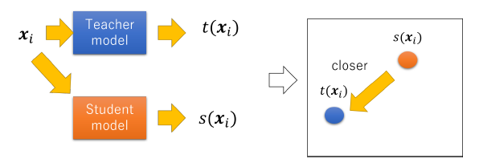
Knowledge Distillation
Knowledge distillation is a technique for transferring knowledge of deep or ensemble model with many parameters (teacher model) to smaller shallow model (student model).

Slide 9
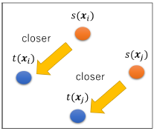


Hinton’s KD
Hinton et al. [2] proposed training the student model so that the softmax outputs of the teacher model and the softmax outputs (probability) of the student model are close (HKD).
They used the KL-divergence of the softmax outputs of both models as the loss for training the student model.

Slide 10
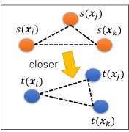



Park’s KD
Park et al. [3] expressed the relationship between the outputs of the teacher model as the Euclidean distance between the two outputs, and transferred it to the student model (RKD-D).
Optimized the student model by Huber loss so that the similarity between the outputs of the student model and the similarity of the outputs of the teacher model got closer.

Slide 11

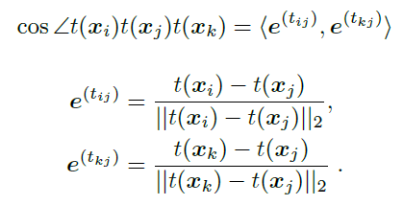

Park’s KD
They also used the cosine of the angle formed by the three outputs as the similarity of the model outputs (RKD-A).
Optimized the student model by Huber loss so that the similarity between the outputs of the student model and the similarity of the outputs of the teacher model got closer.

Slide 12
Park’s KD
They also argued that using both angles and Euclidean distance for knowledge transfer would further improve the performance of the student model (RKD-DA).

Slide 13
02
Project Expectations

Slide 14
Expected Deliverables
Analysing and Creating Dataloaders for different Datasets (MNIST, FashionMNIST, CIFAR10)
Build and Train the Teacher Model
Build the Student Model and Distill the Knowledge from the Teacher
Analyse the effect of using Triplet Loss along with Hinton’s KL Divergence and Park’s RKD-DA Losses

Slide 15
03
Implementation Details

Slide 16
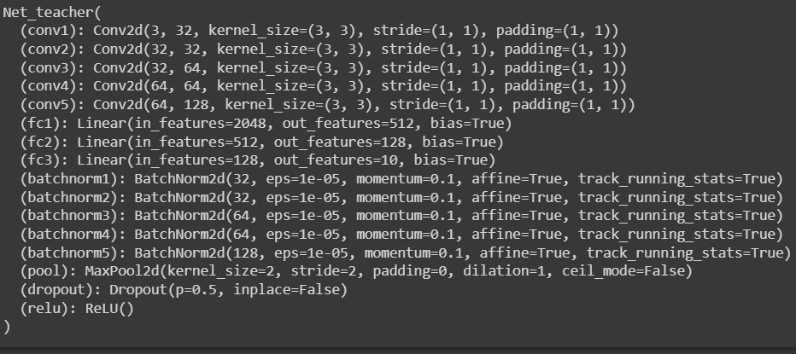
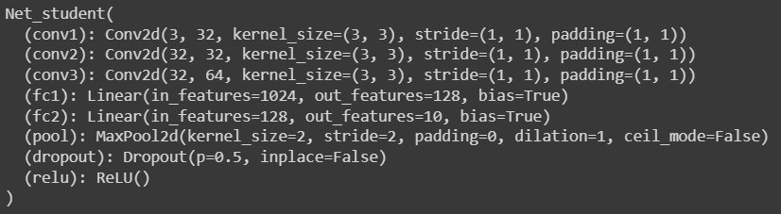
CIFAR 10 Model
CIFAR-10 is a dataset that includes color images of 10 kinds
of objects such as ”automobile” and ”dog.”
The size of each image in CIFAR-10 is 32 x 32.
The numbers of the training samples and the test samples are 50,000 and 10,000.

Slide 17
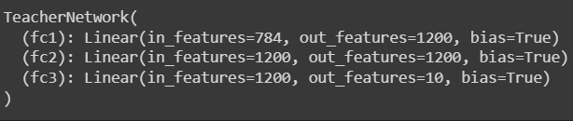

MNIST Model
MNIST is a dataset of handwritten digits.
The size of each image in CIFAR-10 is 28 x 28.
The numbers of the training samples and the test samples are 60,000 and 10,000.

Slide 18
Fashion MNIST Model
Fashion MNIST is a dataset of Zalando's article images
The size of each image in CIFAR-10 is 28 x 28.
The numbers of the training samples and the test samples are 60,000 and 10,000.

Slide 19




Evaluation
Loss : Distillation loss uses the soft targets to minimize the squared difference between the logits produced by the teacher model and the logits produced by the student model.
Accuracy : Accuracy is a metric that generally describes how the model performs across all classes. It is calculated as the ratio between the number of correct predictions to the total number of predictions.

Slide 20
Implementation Details
Network Implemented using Pytorch
Distillation Loss Calculation
Data Loader Built for Triplets
Student Model Distilled with Early Stopping
Both Teacher and Student Models are implemented. Teacher model is first trained and then distillation performed onto the student.
Triplet Loss + HKD Loss + RKD-DA Loss implemented from scratch
Each Triplet has an Anchor, Positive and Negative sample
All losses and metrics are logged and visualized
1
2
3
4

Slide 21
04
Results

Slide 22
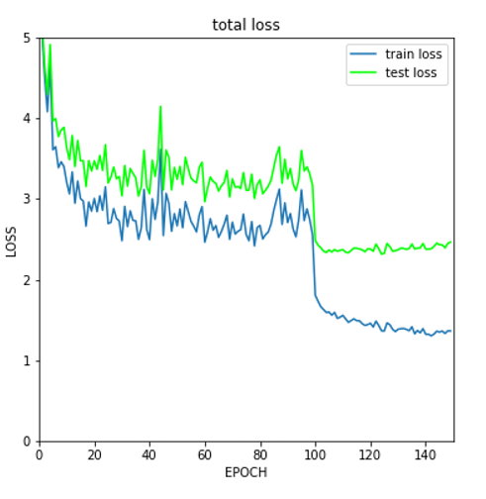
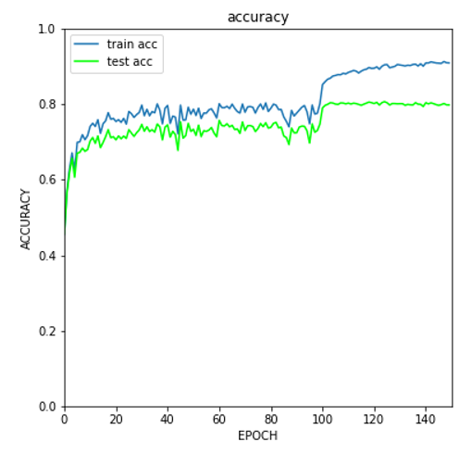
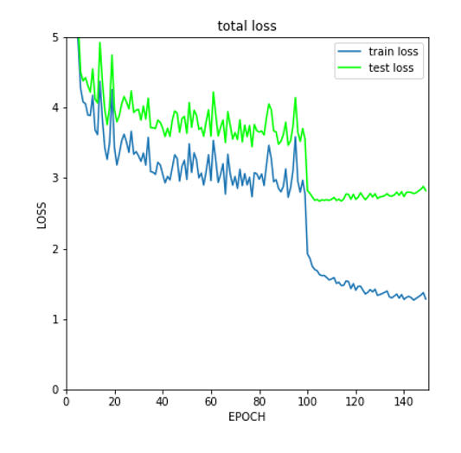
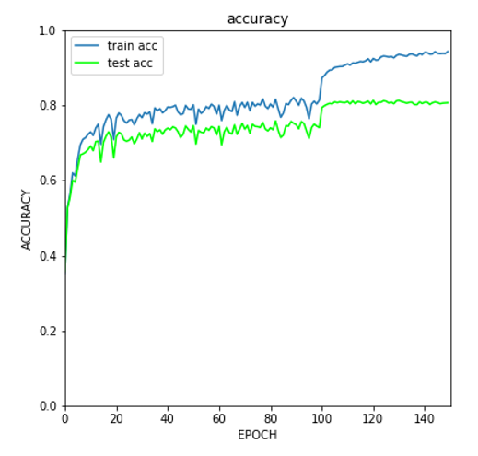
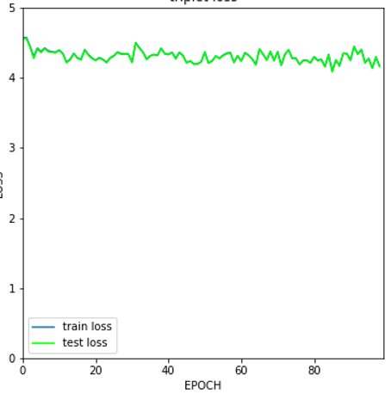
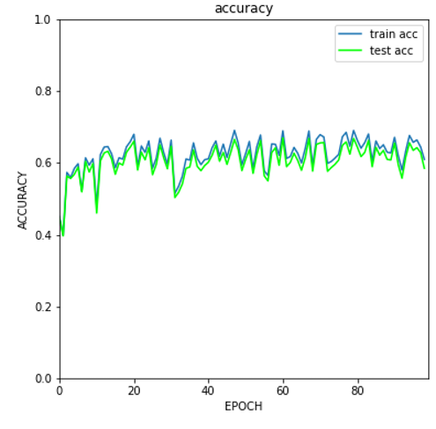
Loss Curves - CIFAR 10
Triplet Loss
Triplet Loss + HKD Loss
Triplet Loss + HKD Loss + RKD-DA Loss

Slide 23
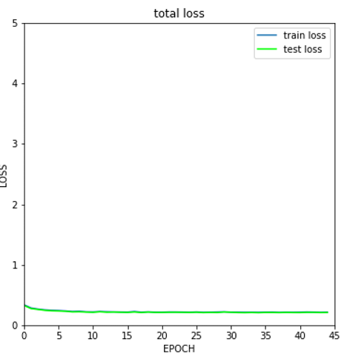
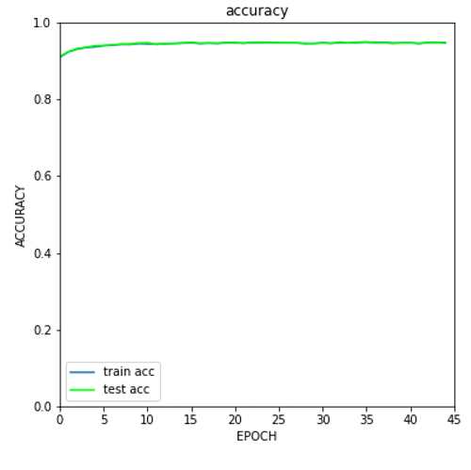
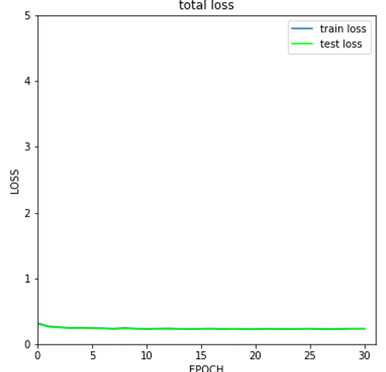
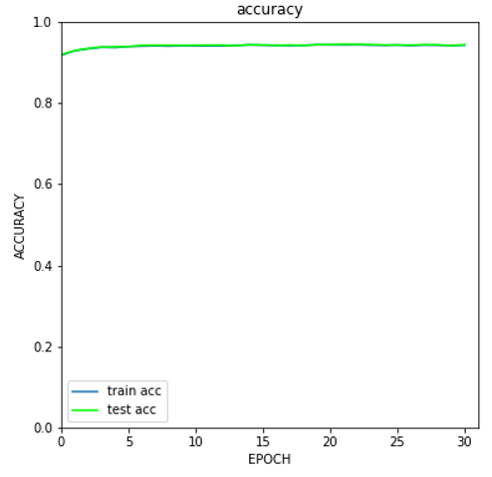
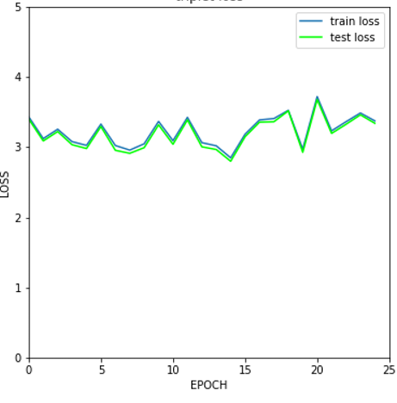
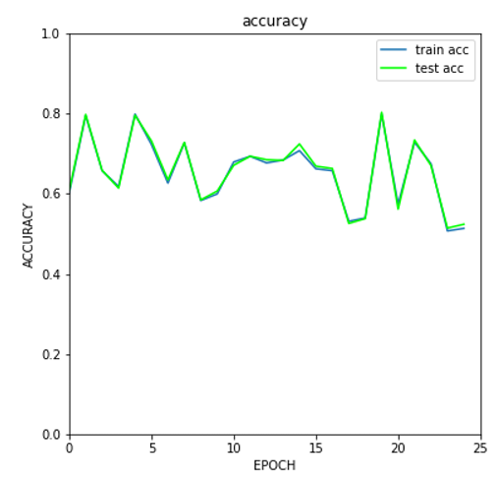
Loss Curves - MNIST
Triplet Loss
Triplet Loss + HKD Loss
Triplet Loss + HKD Loss + RKD-DA Loss

Slide 24
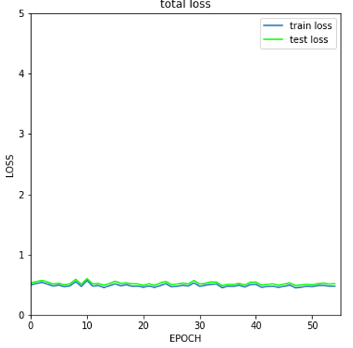
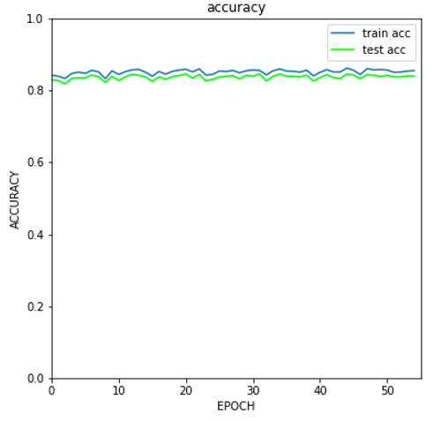
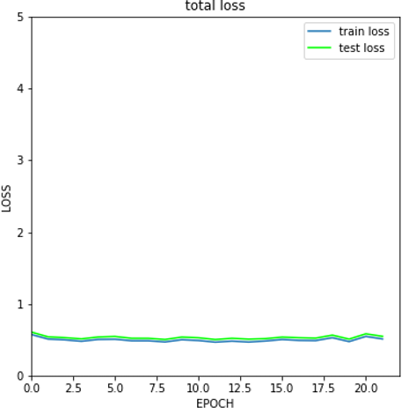
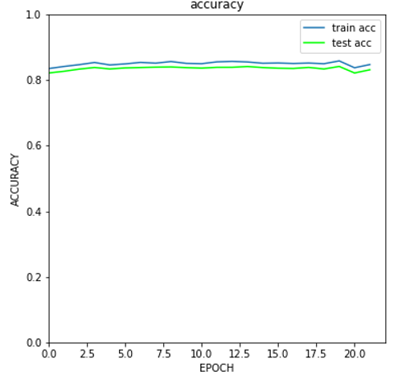
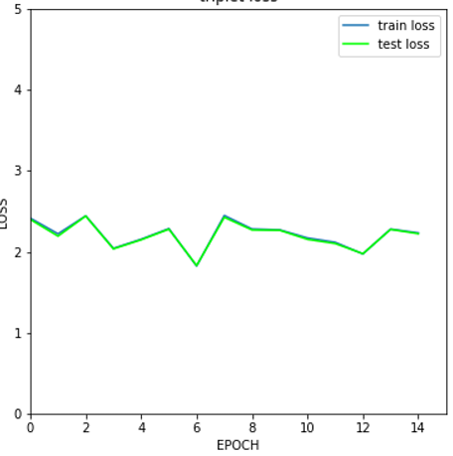
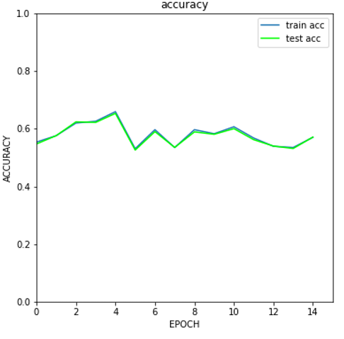
Loss Curves - Fashion MNIST
Triplet Loss
Triplet Loss + HKD Loss
Triplet Loss + HKD Loss + RKD-DA Loss

Slide 25
Results
Dataset | Loss Used | Test Loss | Test Accuracy
CIFAR10 | Triplet | 2.464 | 0.7979
 | Triplet + HKD | 2.8216 | 0.8068
 | Triplet + HKD + RKD-DA | 15.1264 | 0.585
MNIST | Triplet | 0.2108 | 0.9481
 | Triplet + HKD | 0.2331 | 0.9434
 | Triplet + HKD + RKD-DA | 13.5119 | 0.5237
Fashion MNIST | Triplet | 0.5199 | 0.8396
 | Triplet + HKD | 0.5486 | 0.831
 | Triplet + HKD + RKD-DA | 10.0567 | 0.571

Slide 26
Achievements
Train Teacher-Student network with Knowledge Distillation over the datasets - CIFAR 10, MNIST, Fashion MNIST.
Set up 3 different losses for KD - Triplet Loss, Hinton’s KL-divergence and Park’s Relational KD with both Distance and Angle.
Set up Early Stopping to Prevent Overfitting.
Train the Teacher Model and freeze the parameters. Distill the knowledge onto the Student Model using the Distillation Losses implemented.
Understand the working of Knowledge Distillation in Neural Networks.

Slide 27
05
Future Steps

Slide 28
Next Steps
Study the effect of Distillation Losses when the networks are deeper.
Use hard sampling and select negative samples that are difficult for the model to learn instead of random sampling.
Explore larger datasets to verify performance of the distillation loss.

Slide 29
06
References

Slide 30
References
H. Oki, M. Abe, J. Miyao and T. Kurita, "Triplet Loss for Knowledge Distillation," 2020 International Joint Conference on Neural Networks (IJCNN), 2020, pp. 1-7, doi: 10.1109/IJCNN48605.2020.9207148.
Geoffrey Hinton, Oriol Vinyals, and Jeff Dean. Distilling the knowledge in a neural network. arXiv preprint arXiv:1503.02531, 2015.
Wonpyo Park, Dongju Kim, Yan Lu, and Minsu Cho. Relational knowledge distillation. In Proceedings of the IEEE Conference on Computer Vision and Pattern Recognition, pages 3967–3976, 2019.

Slide 31
Thanks!
...

